Slide 1
Your Data Science Future
Programming Languages, Courses, Statistics, Future Developments in Tech

Slide 2
Required Skills
Job Titles
Programming Languages (Python, R, SQL, SAS, C/C++, Haddop, Java, Matlab, etc.)
Technical Writing
Soft Science Expertise (Business, Finance, Neuroscience, Biology, Sports, etc.)
Communication
Mathematics/Statistics/Machine Learning
Data Mining/Cleaning
Data Visualization
Data Scientist
Data Analyst
Business Analyst
Financial Analyst
Statistician
Operations Research Analyst
Data Architect
Data Engineer

Slide 3
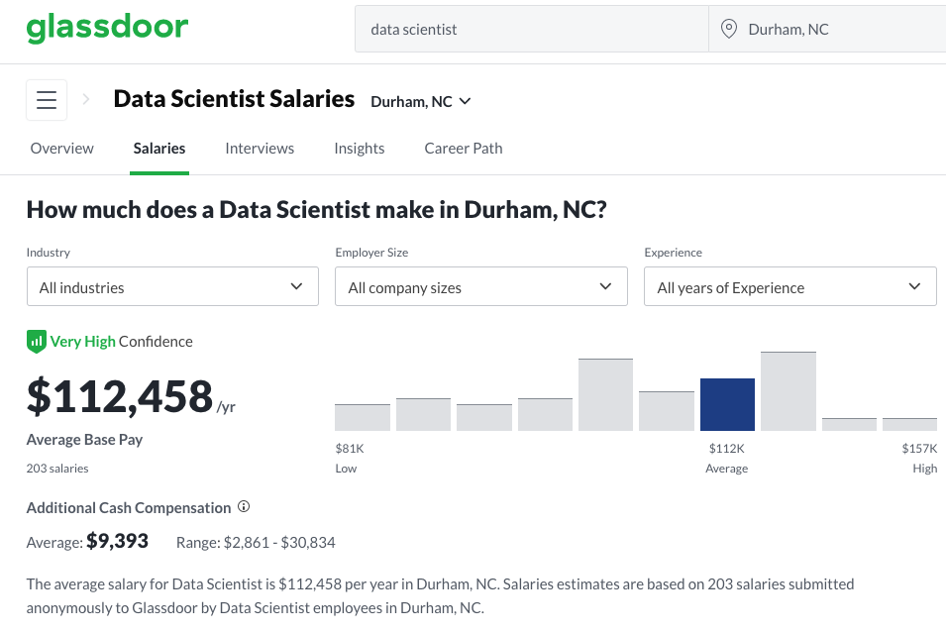
Data Science is Lucrative

Slide 4
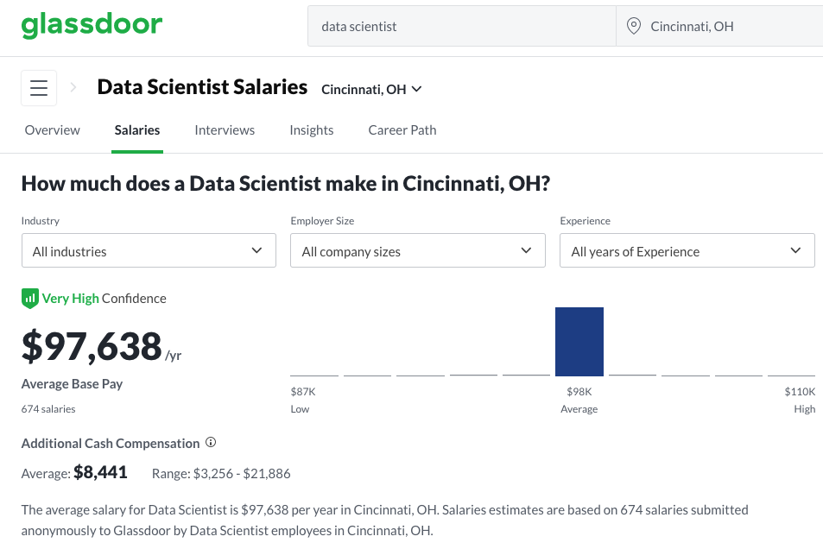
Data Science is Lucrative

Slide 5
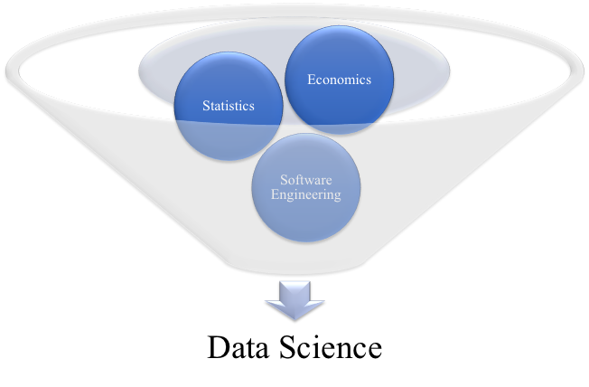
Data Science Courses

Slide 6
Computer Science Lower Levels
1st - Introductory Computer Programming
Often in Python
Duke: Compsci101
How to write and debug code
How to manage program complexity and learn basic programming knowldge
2nd - Data Structures and Algorithms
Often in Java
Duke: Compsci201
Deals with tradeoffs in time and memory with structuring data/programs
How to construct and analyze larger programs
? - Computer Architecture
Often in C++
How machines execute programs
? - Discrete Mathematics
Often introduces proofs and introduces math used in higher level CS courses without taking a semester deep dive into such topics in their actual courses
Further reading: https://www.cs.duke.edu/undergrad/starting

Slide 7
Computer Science Upper Levels
? - Artificial Intelligence
Introduction to AI and how machines mathematically construct and “win” games
?? - Machine Learning
Introduction to how computers use data and algorithms that imitate the way humans learn, VERY MATH HEAVY
??? - Natural Language Processing
The study of computing systems which process human languages,
? - Databases
? - Algorithms
? - Data Mining

Slide 8
Mathematics/Statistics
1st - Calculus 1
1st - Linear Algebra
Often helpful to have a proofs course or experience in Math to take before though
2nd - Calculus 2
3rd - Calculus 3
4th - Probability Theory
?? Operations Research
?? Statistical Inference
?? Advanced Linear Algebra
?? Time Series Analysis

Slide 9
Economics/Finance/Other
1st - Introductory/Applications of Data Science
You are Here!
1st - Introductory Microeconomic Theory
1st - Introduction to Finance
2nd - Introductory Macroeconomic Theory
? - Game Theory
? - Econometrics

Slide 10
Programming Languages
Computer languages are structured from high to low…
A good place to check the pros and cons of a computer language can be found at https://www.slant.co/topics/25/~best-programming-language-to-learn-first
Object oriented vs. …
Static vs non static …
Compilation …
Running time vs memory vs understandability vs functionality …

Slide 11
Python
The Good
The Bad
Easy to get started
Many libraries of pre-made code
Good documentation and strong community user base to ask questions
Very similar to pseudo-code (resembles human logic well)
Relatively simple to learn
Easy to find jobs
Useful in many domains
Slow to execute
Does not teach about data types
Harder to pick up lower level computer languages
Harder to debug code due to low barrier to entry of use

Slide 12
Java
The Good
The Bad
Consistent programming standards
Excellent feedback errors with their integrated development environments
Most commonly used language in industry (not data science)
Many libraries and APIs with pre-made code
Too verbose

Slide 13
C++
The Good
The Bad
Easy to get started
Many libraries of pre-made code
Good documentation and strong community user base to ask questions
Very similar to pseudo-code (resembles human logic well)
Relatively simple to learn
Easy to find jobs
Useful in many domains
Slow to execute
Does not teach about data types
Harder to pick up lower level computer languages
Harder to debug code due to low barrier to entry of use

Slide 14
R
The Good
The Bad
Easy to get started
Many libraries of pre-made code
Good documentation and strong community user base to ask questions
Very similar to pseudo-code (resembles human logic well)
Relatively simple to learn
Easy to find jobs
Useful in many domains
Slow to execute
Does not teach about data types
Harder to pick up lower level computer languages
Harder to debug code due to low barrier to entry of use

Slide 15
SQL
The Good
The Bad
Easy to get started
Many libraries of pre-made code
Good documentation and strong community user base to ask questions
Very similar to pseudo-code (resembles human logic well)
Relatively simple to learn
Easy to find jobs
Useful in many domains
Slow to execute
Does not teach about data types
Harder to pick up lower level computer languages
Harder to debug code due to low barrier to entry of use

Slide 16
Matlab
The Good
The Bad
Easy to get started
Many libraries of pre-made code
Good documentation and strong community user base to ask questions
Very similar to pseudo-code (resembles human logic well)
Relatively simple to learn
Easy to find jobs
Useful in many domains
Slow to execute
Does not teach about data types
Harder to pick up lower level computer languages
Harder to debug code due to low barrier to entry of use

Slide 17
SAS
The Good
The Bad
Easy to get started
Many libraries of pre-made code
Good documentation and strong community user base to ask questions
Very similar to pseudo-code (resembles human logic well)
Relatively simple to learn
Easy to find jobs
Useful in many domains
Slow to execute
Does not teach about data types
Harder to pick up lower level computer languages
Harder to debug code due to low barrier to entry of use

Slide 18
Stata
The Good
The Bad
Easy to get started
Many libraries of pre-made code
Good documentation and strong community user base to ask questions
Very similar to pseudo-code (resembles human logic well)
Relatively simple to learn
Easy to find jobs
Useful in many domains
Slow to execute
Does not teach about data types
Harder to pick up lower level computer languages
Harder to debug code due to low barrier to entry of use

Slide 19
HTML (Technically Not a Language)
The Good
The Bad
Easy to get started
Many libraries of pre-made code
Good documentation and strong community user base to ask questions
Very similar to pseudo-code (resembles human logic well)
Relatively simple to learn
Easy to find jobs
Useful in many domains
Slow to execute
Does not teach about data types
Harder to pick up lower level computer languages
Harder to debug code due to low barrier to entry of use

Slide 20
Projects Matt and Ben Have Done
https://github.com/NolanSmithSolutions/
Not just our lectures - sometimes we put up non-proprietary projects or stuff we do for fun.

Slide 21
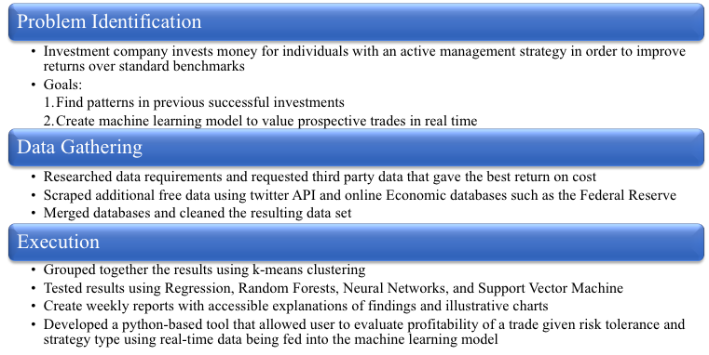
Predictive Financial Model

Slide 22
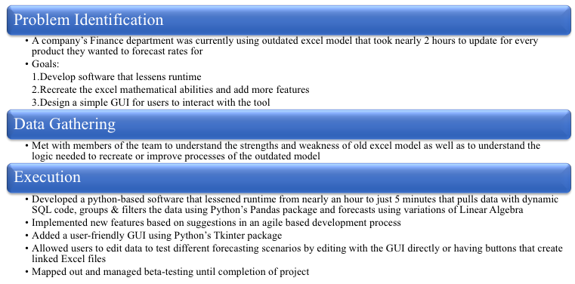
Python Automation Tool w/ GUI

Slide 23
Weekly Readings/Videos
https://news.berkeley.edu/2018/05/31/those-four-wheeled-robots-on-campus-explained/
https://www.businessinsider.com/how-app-developers-keep-us-addicted-to-our-smartphones-2018-1#instagram-sends-dozens-of-push-notifications-each-week-and-uses-stories-to-attract-you-1
https://www.mentalfloss.com/article/520897/ai-program-wrote-harry-potter-fan-fiction-and-results-are-hilarious

